Slide 1
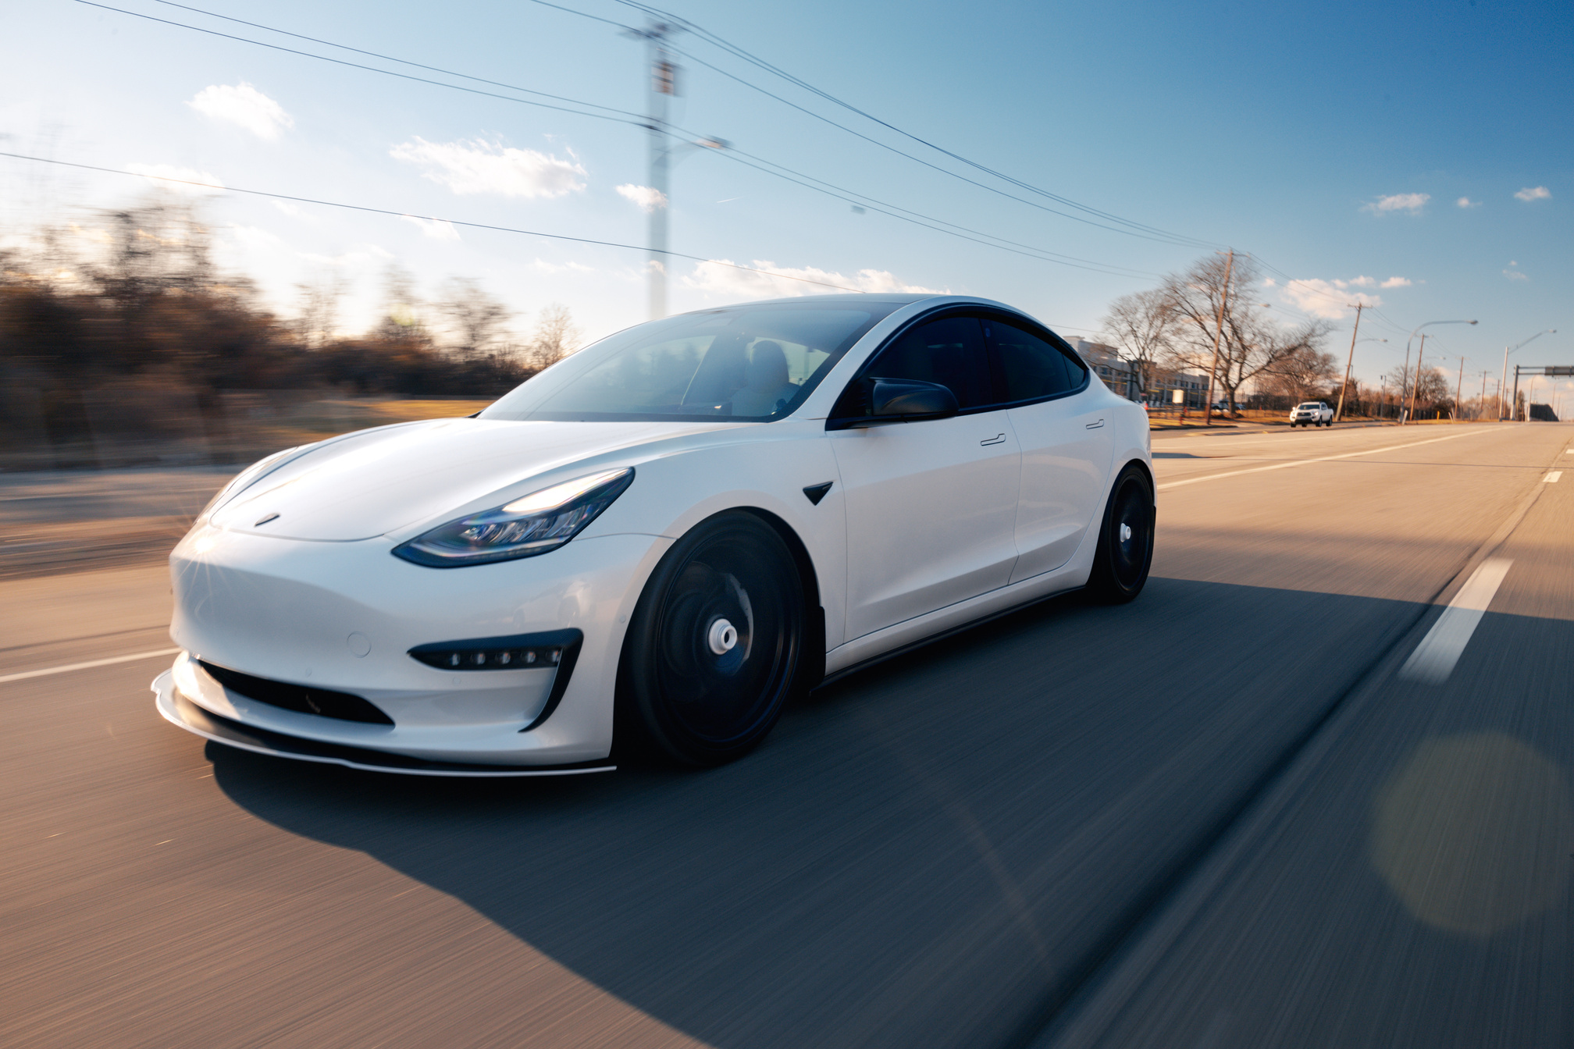


GA Capstone Project
EV Population Analysis in Washington State
Presented By:
Yusuf Aldamami

Slide 2

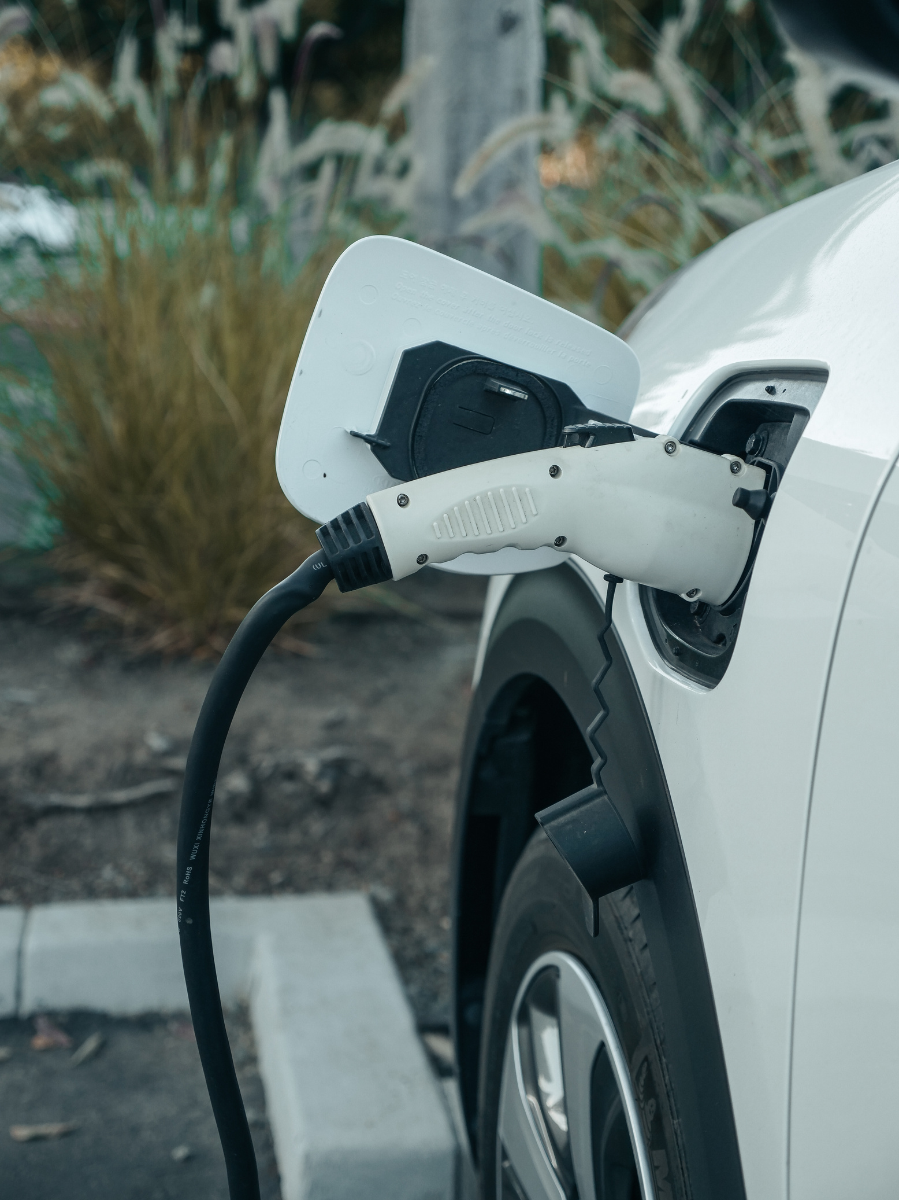

Powered by Electricity instead of gasoline or diesel
About Electric Cars
Lower operating costs and has
modern technology features
No exhaust, less pollution, supports a sustainable future

Slide 3

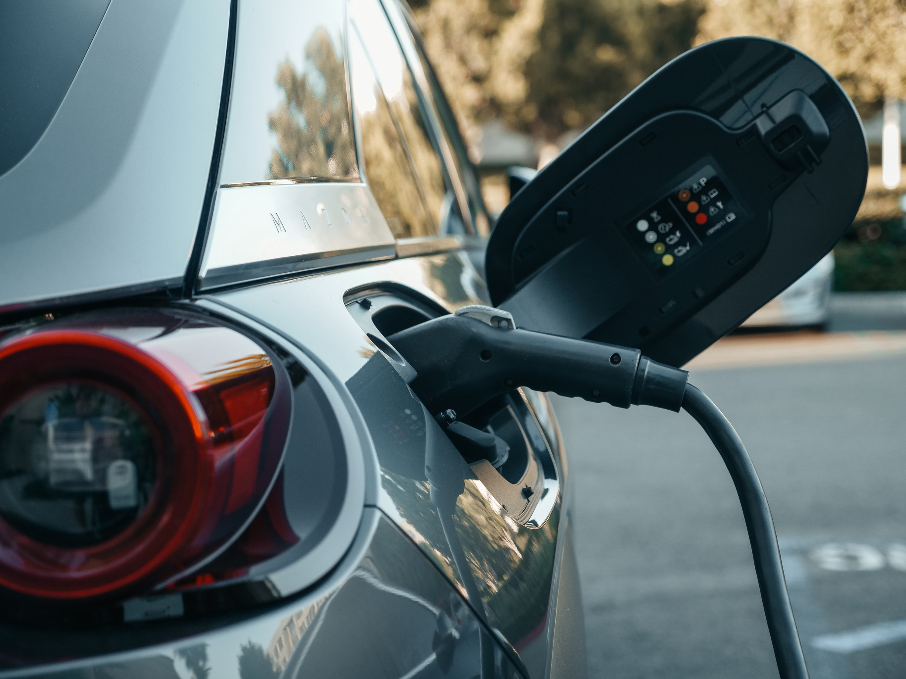
Problem Statement
As Washington State accelerates its transition to electric vehicles overall adoption continues to grow, yet adoption remains uneven with underserved counties falling behind due to unknown reasons.

Slide 4
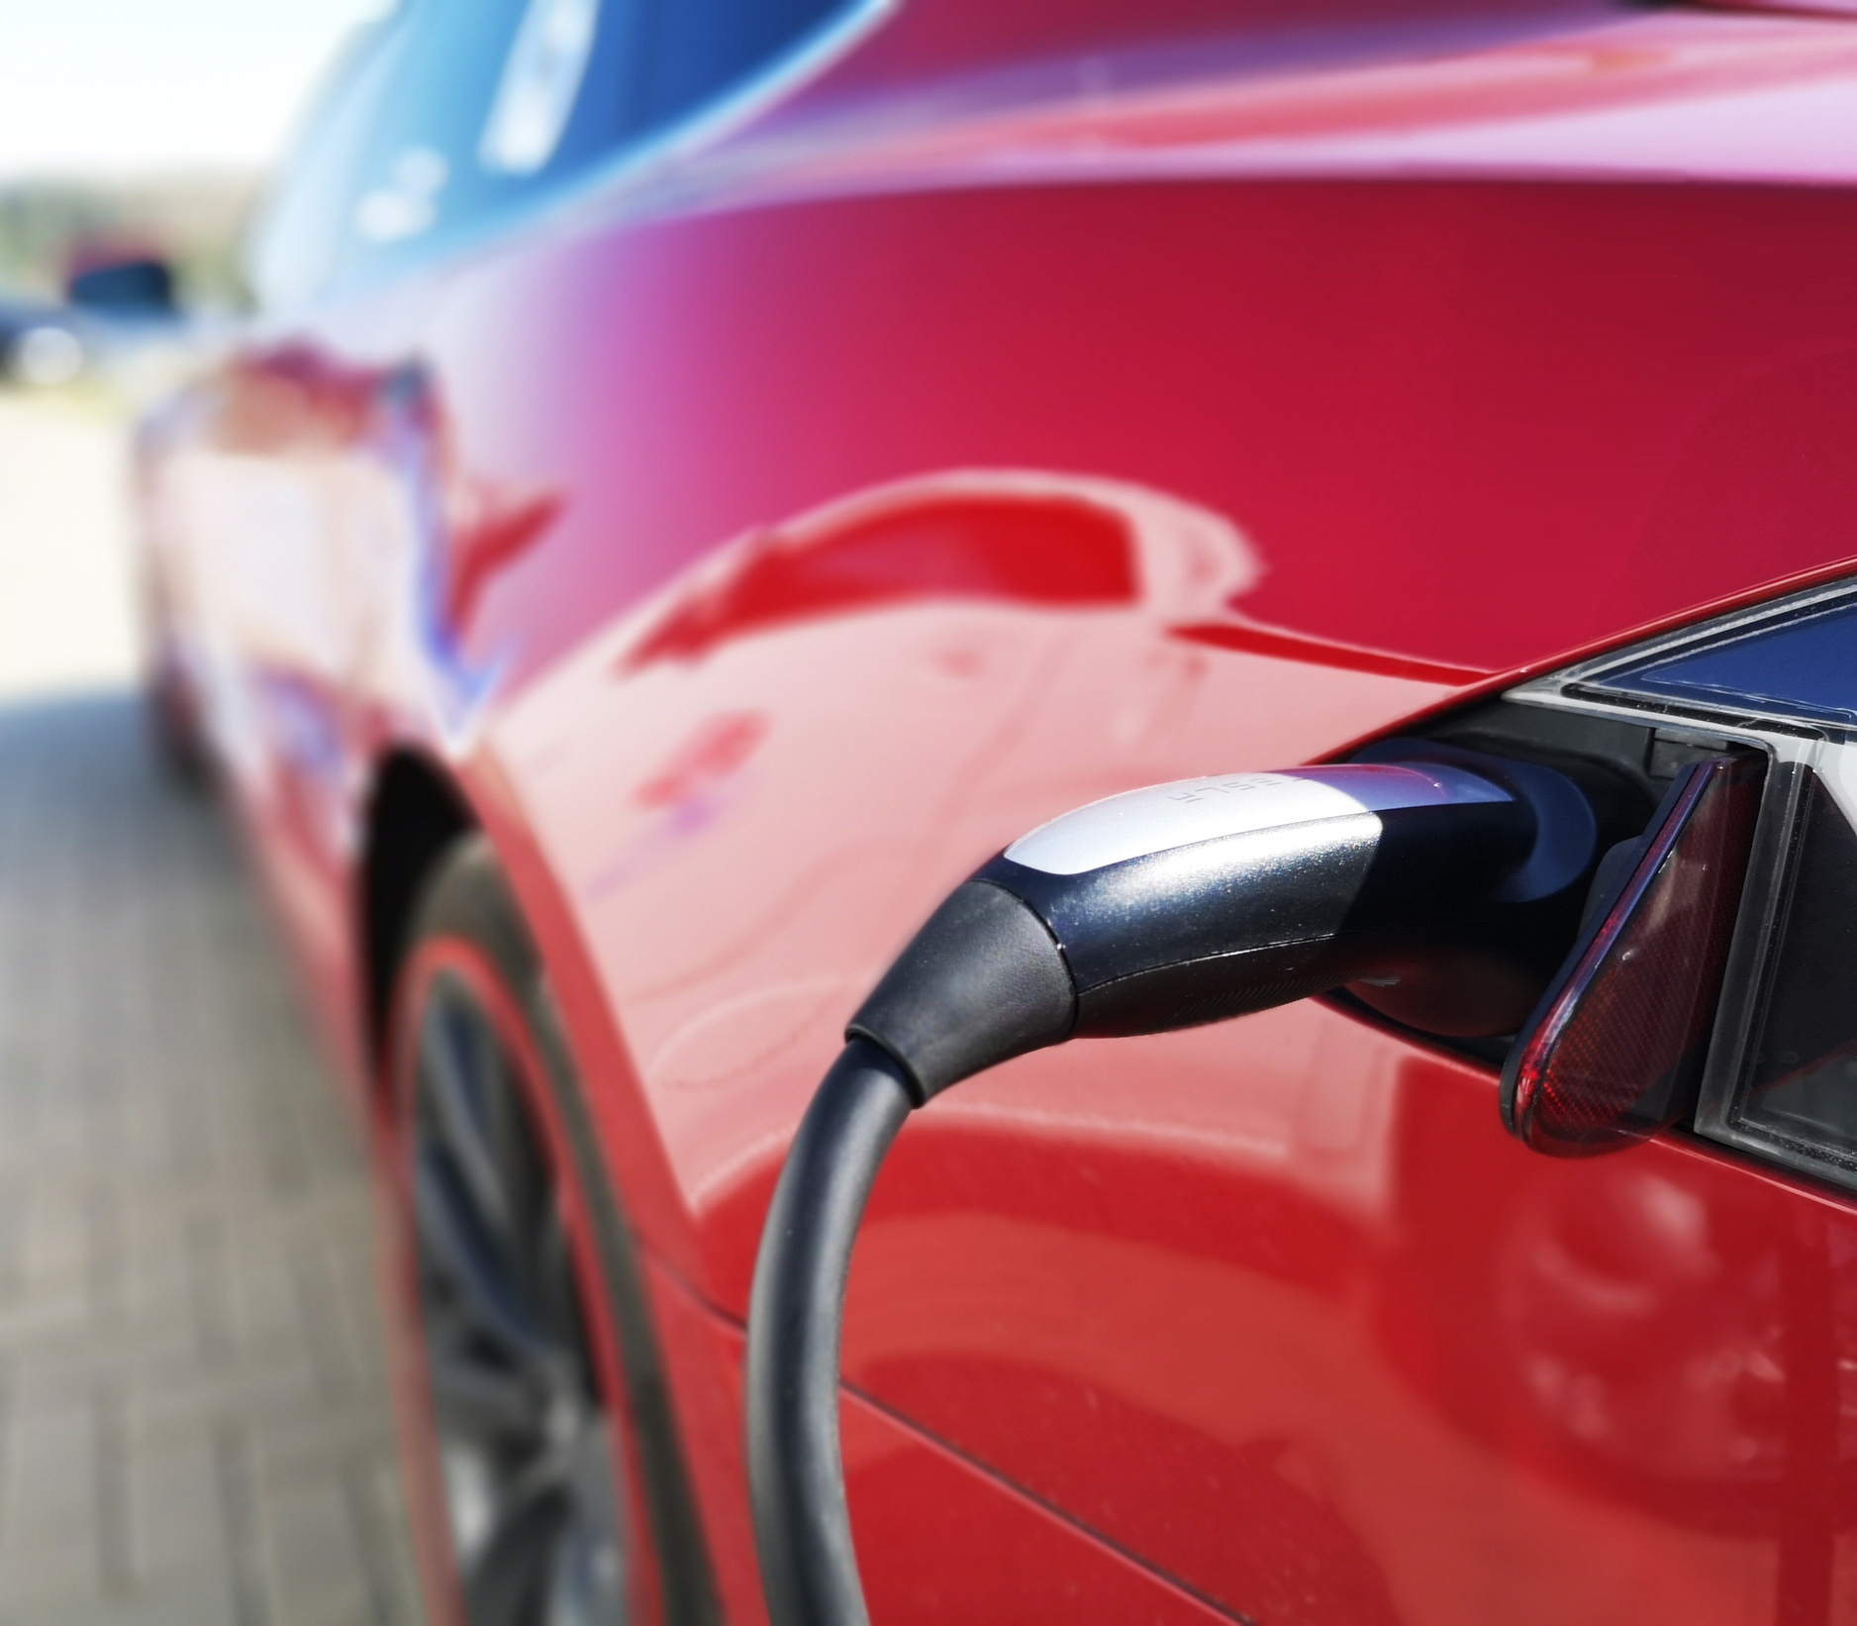
Aim
To analyze the distribution and characteristics of electric vehicles in Washington State to
Identify trends
Highlight top Ev regions
Provide understanding of the Ev space for the target audience

Slide 5





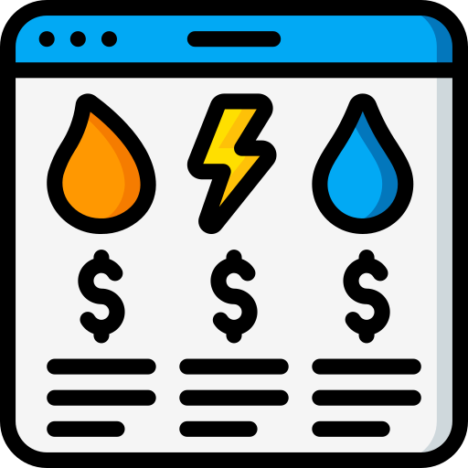
Target Audience
Car
Makers
Policymakers
And authorities
Utility companies
Investors in
EV infrastructure

Slide 6

Objectives
Measure EV adoption volumes and trends
Highlight policy and awareness challenges
Identify leading and underserved counties
Recommend investment priorities

Slide 7
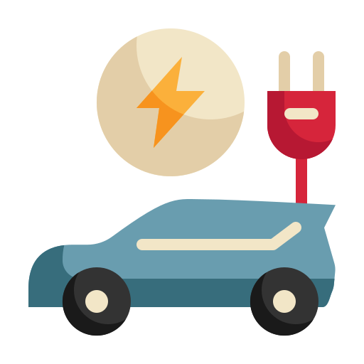

What Are PHEV?
Video
Stands for Plug in Hybrid Vehicles
Use electric motor combined with a combustion engine
Improve gas efficiency
More green than gas cars but less eco friendly compared to EVs

Slide 8
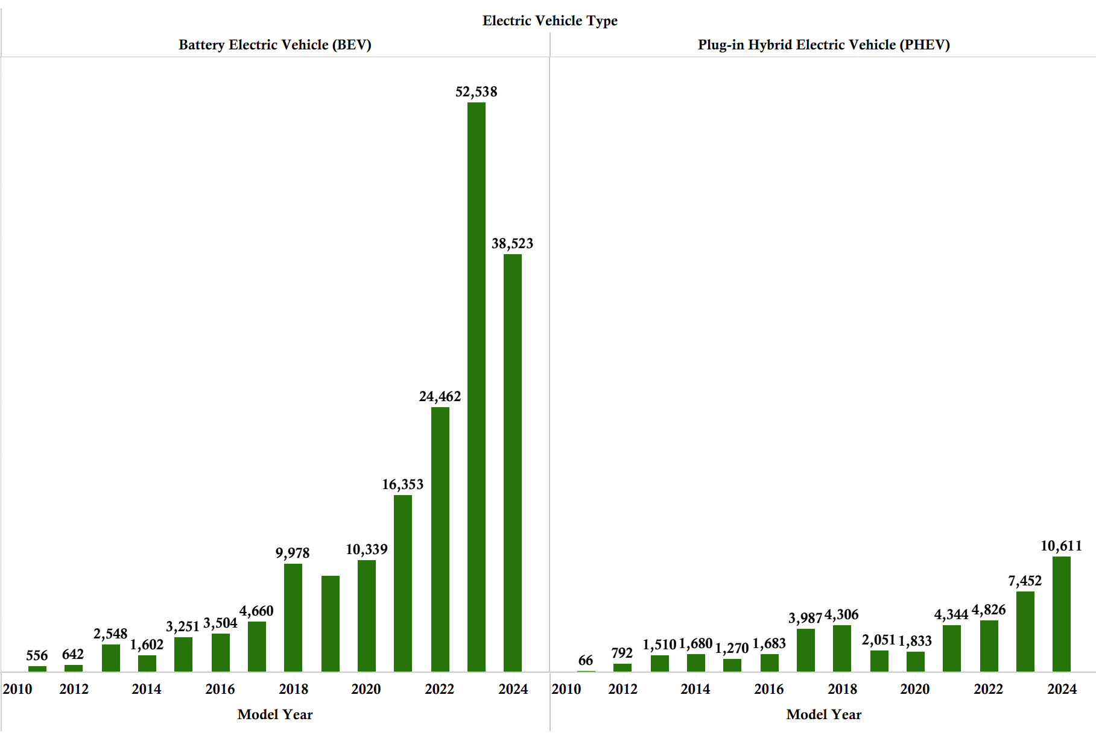
BEV vs PHEV
Fully electric battery powered vehicles consistently outnumber plug‑in hybrids across most years

Slide 9
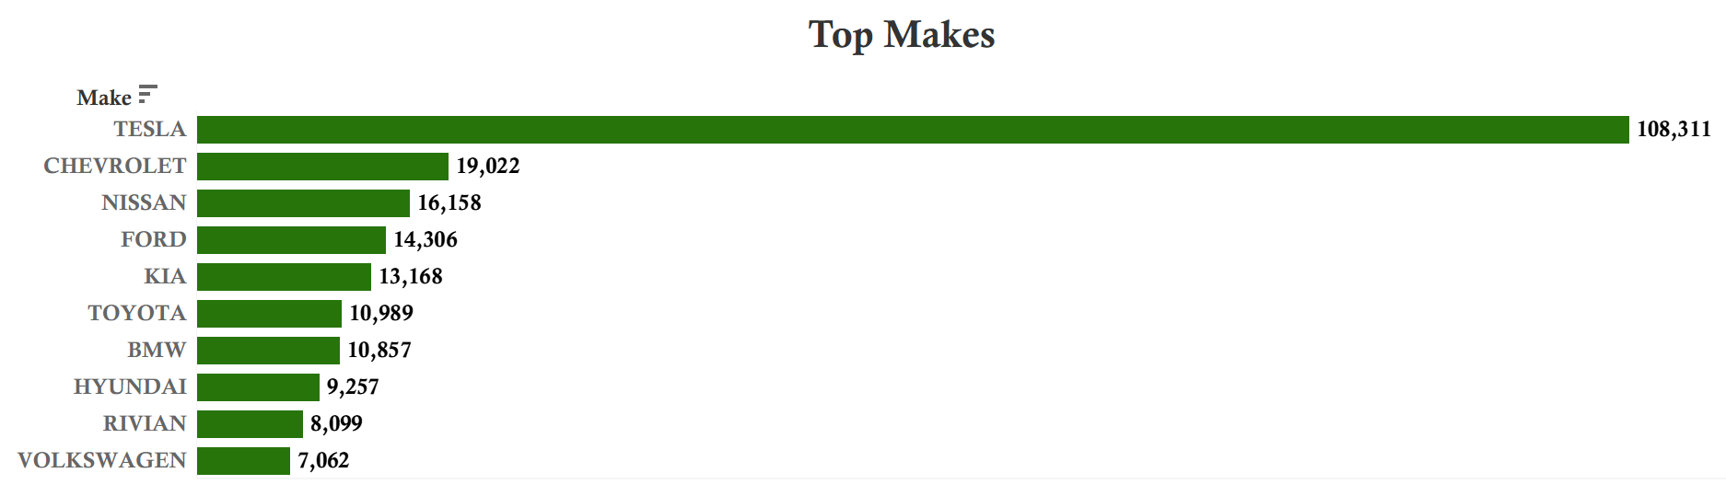
Dominant Car Brands
The EV population is heavily concentrated with Tesla leading the market

Slide 10
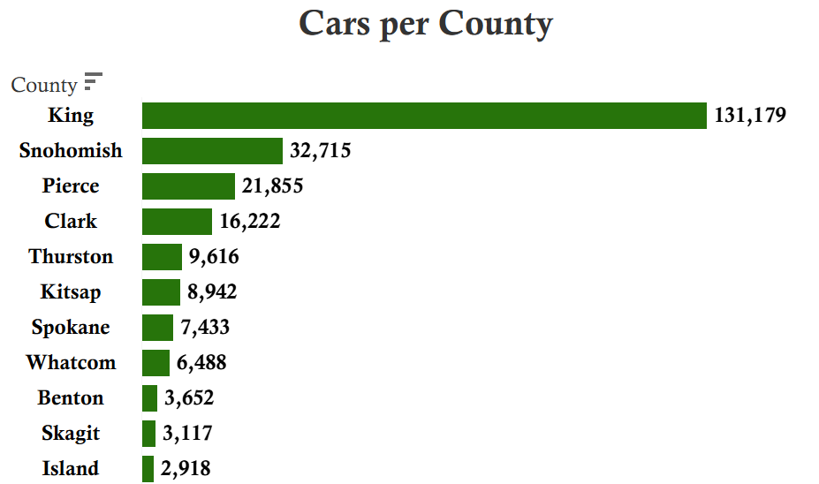
Top Performing Counties
Top counties consistently show strong EV adoption due to a dense population and major cities being under them.

Slide 11
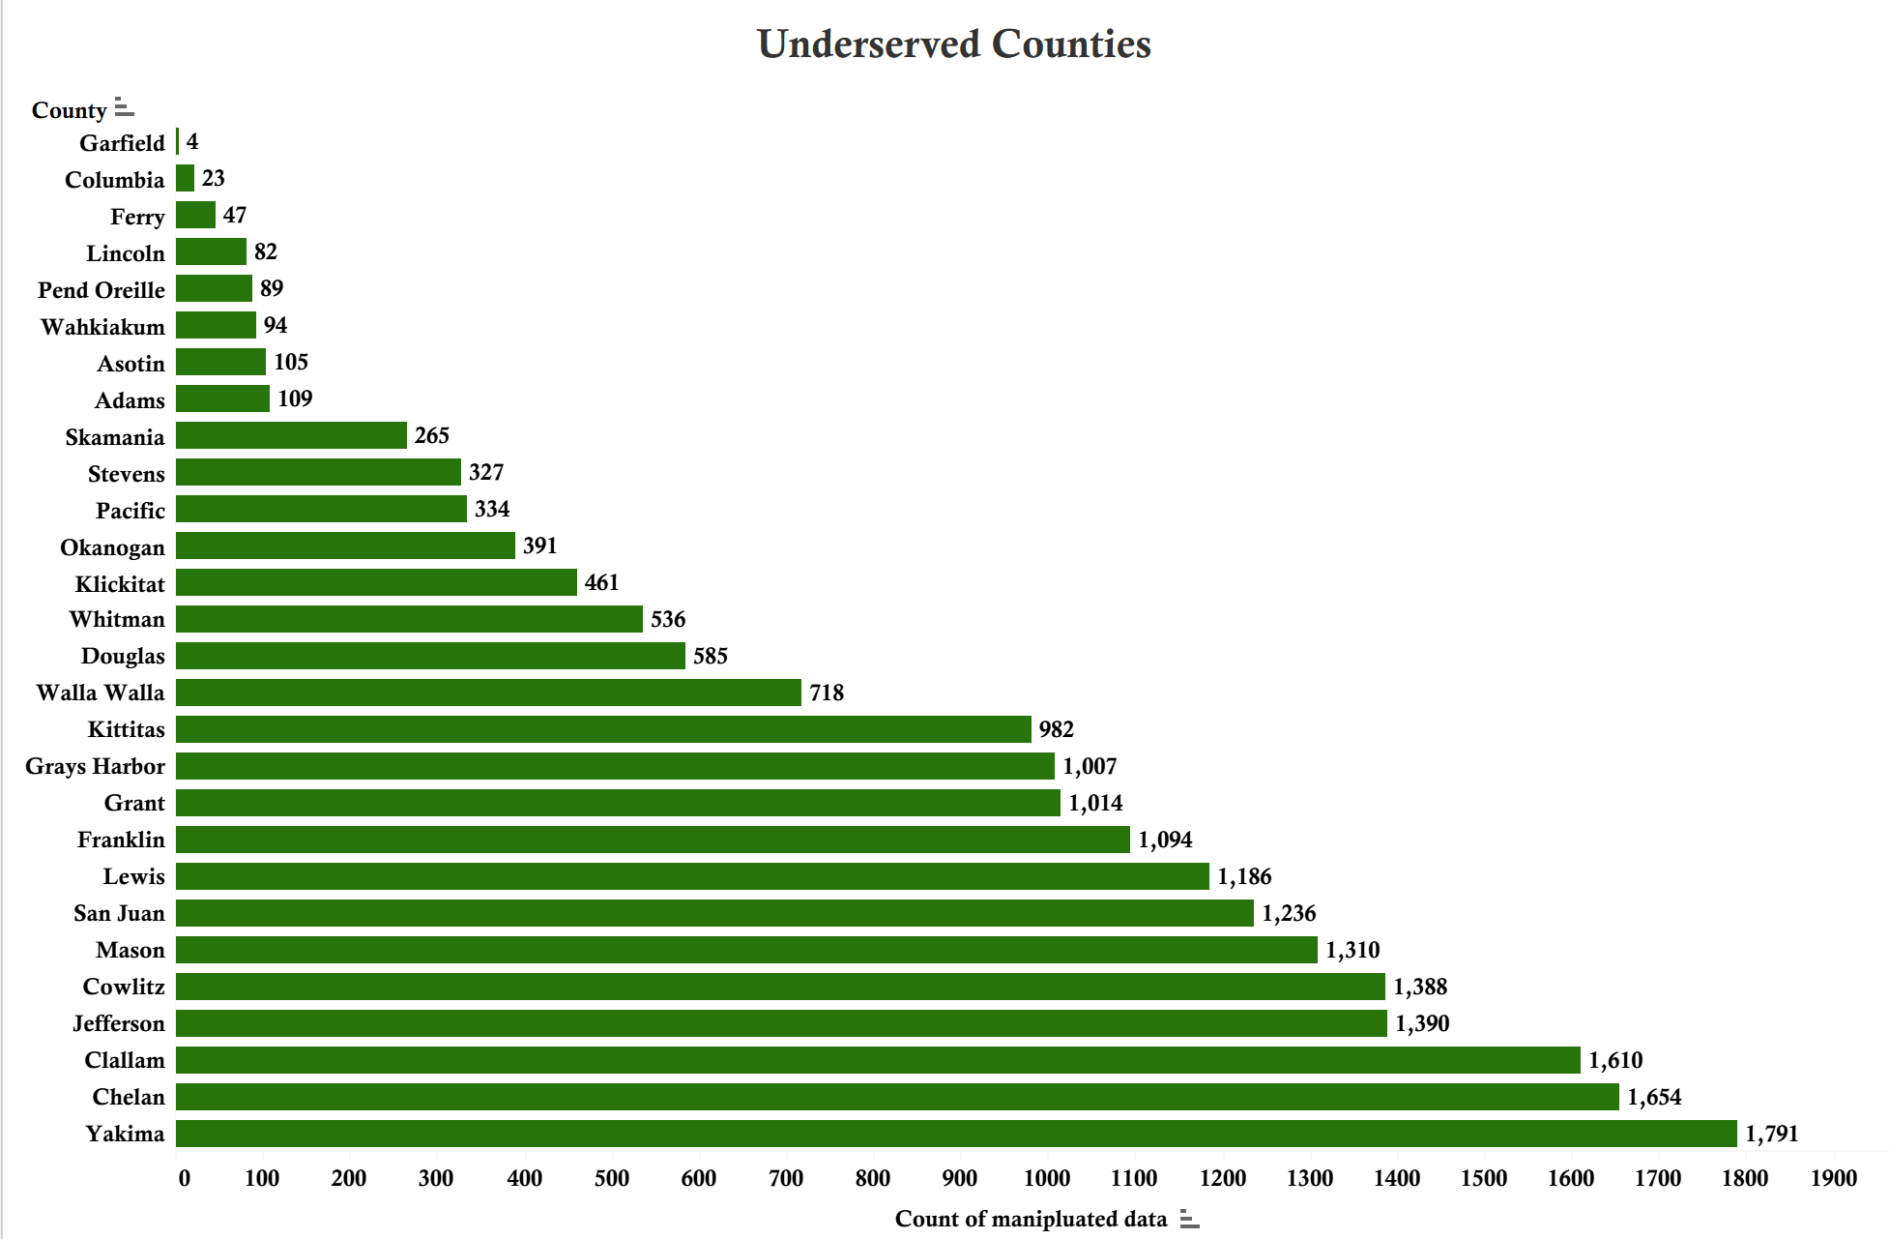
Underserved Regions
Colder and less popular with EV’s due to less accessible charging stations

Slide 12

Clean Alternative Fuel Vehicle Program
Managed by the U.S Department of Energy
Promoting scientific and technological innovation
Measured based on vehicle type and electric range
Determines access to incentives tax credits which reduces electric vehicles cost to consumers in the USA

Slide 13
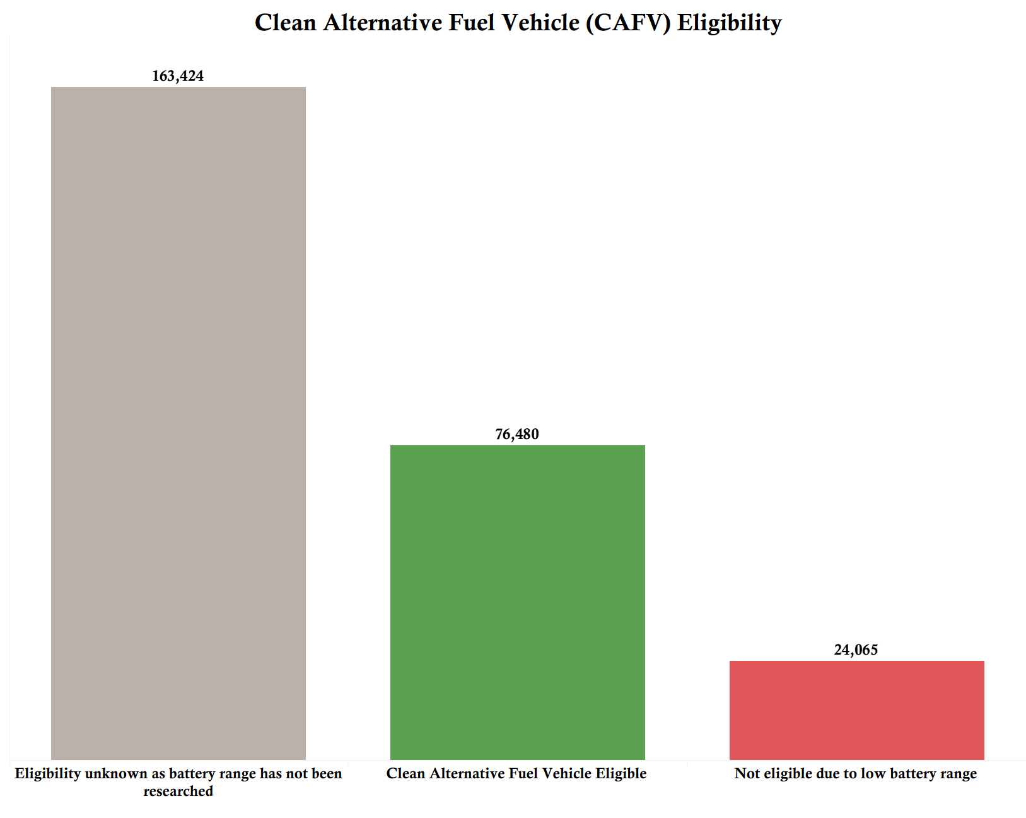
CAFV Eligibility
Most vehicles show “Unknown” due to constant model updates and recalls due to new technological changes and safety concerns

Slide 14
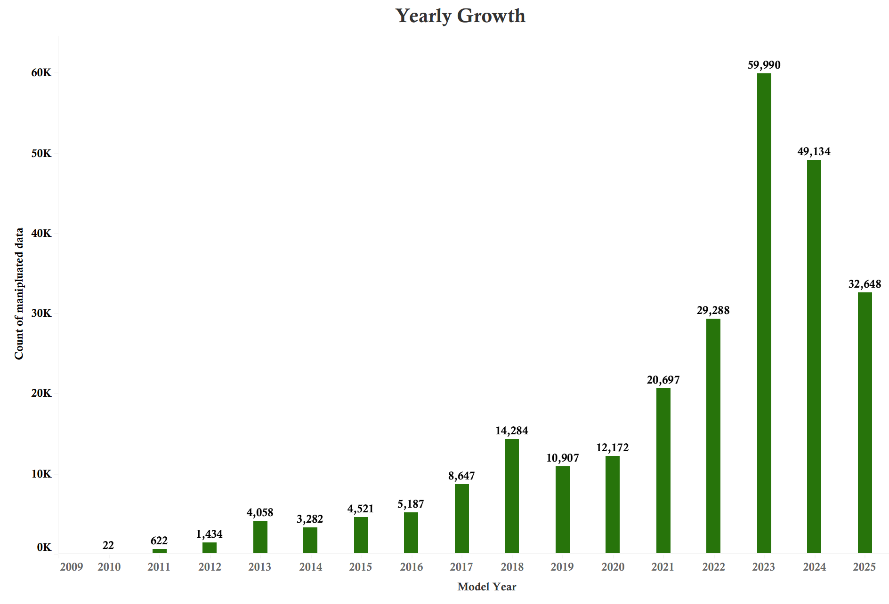
New Registrations Over The Years
Recent dip in 2024 show a slight decline due to market saturation supply chain shifts and stricter CAFV Eligibility

Slide 15
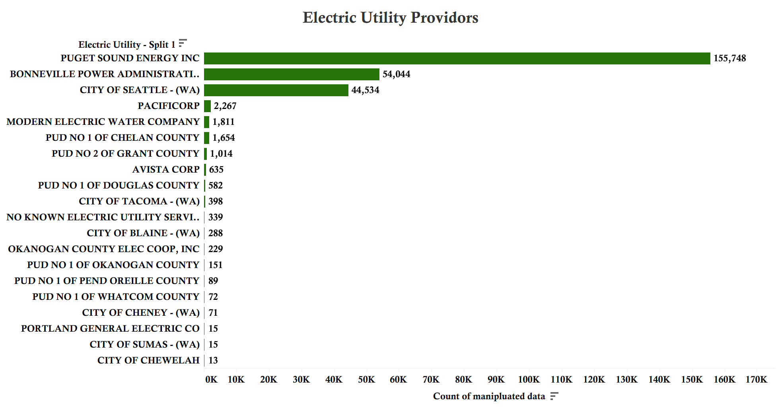
Charging Station Providers
Puget Sound Energy dominates with over 155k EVs rely on Puget Sound Energy for charging making it the state’s most critical utility for EV infrastructure.
Bonneville Power Administration and City of Seattle serve tens of thousands of EVs, showing strong urban coverage.
Smaller providers support niche regions often in remote or underserved areas.

Slide 16
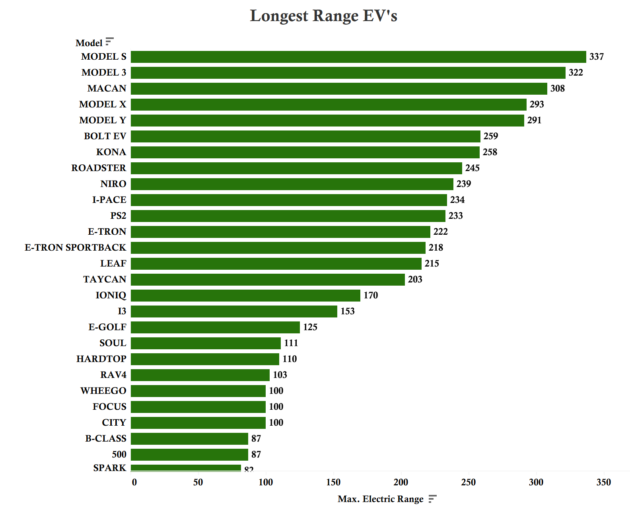
Electric Range (in miles)
For drivers with range anxiety Tesla’s are the top choice

Slide 17
Recommendations
Improve Charging Infrastructure
Prioritize underserved counties with limited access
Working with smaller utilities to install fast charging stations in remote and colder regions
Boost Public Awareness
Run targeted campaigns on EV benefits like cost savings and CAFV eligibility
Partner with local governments and community groups to build trust and visibility
Leverage Policy Incentives
Clarify CAFV eligibility to reduce “unknown” classifications
Promote state and federal incentives more effectively to drive adoption
Support High Performing Regions
Strengthen infrastructure in urban counties to sustain momentum
Benchmark these regions as markers for ideal growth
Data Backed Investments
Give resources to counties with the largest adoption gaps
Track EV growth trends to spot more trends

Slide 18

Initial rows 264,269
Cleaned rows 263,969
Data Overview
Source:
Washington State Electric Vehicle Population Data

Slide 19


Dataset Limitations
Does not include several factors like:
Gas car population
Other states and countries
Income level of purchasers
Missing MSRP prices in many registration entries

Slide 20


Thank You For Listening
Any Questions?

